Slide 1



UNIT 1
LESSON 3
ALL THAT GLITTERS
Part 2

Slide 2
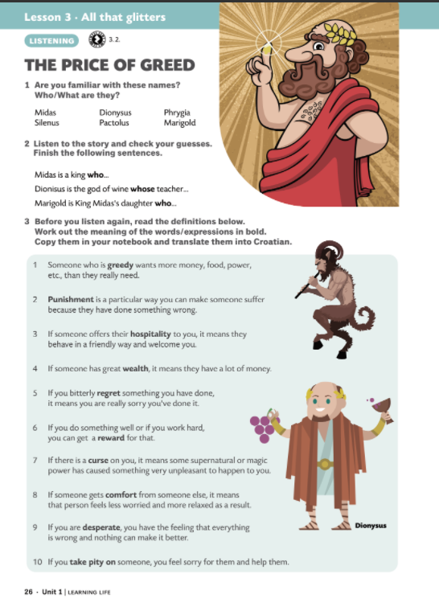
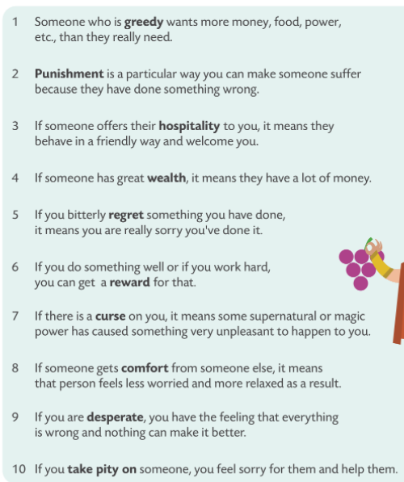


greedy punishment hospitality wealth regret reward curse comfort desperate take pity on
pohlepan
gostoljubivost
bogatstvo
žaljenje
nagrada
kletva
utjeha
očajan
smilovati se

Slide 3
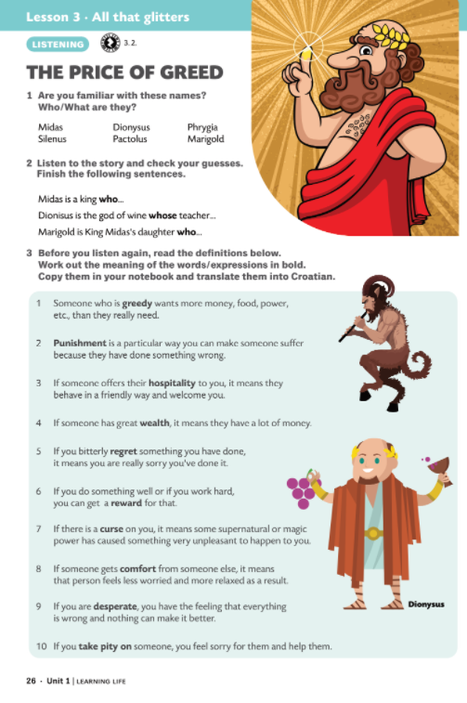

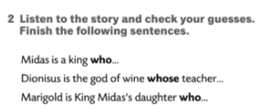
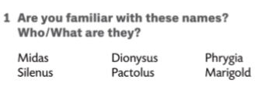

Silenus is a satyr that…
Phrygia is a country where…
Pactolus is the river in which…

Slide 4
Midas is a king who was very rich and greedy/lived in Phrygia, etc.
Dionysus is the god of wine whose tutor was a satyr called Silenus.
Silenus is a satyr that was half man, half goat/fell asleep in King Midas’s garden.
Phrygia is a country where King Midas had a beautiful palace and a rose garden.
Pactolus is the river in which King Midas bathed to get rid of his golden touch.
Marigold is King Midas’s daughter who tried to help her father and was turned to gold.

Slide 5
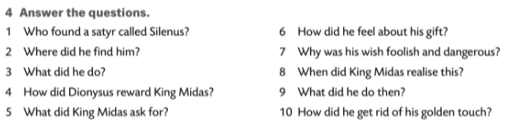
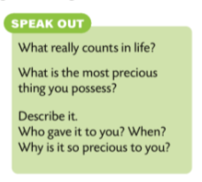

The price of greed (vocabulary)

